Slide 1


Personal Development
Listening Skills

Slide 2
Listening Skills

Slide 3
Agenda
01
Difference between Listening & Hearing
02
Importance of Listening
03
Stages of Listening
04
Reasons for Poor Listening
05
Types of Non listening
06
Types of Listening

Slide 4
What is Listening ?
Someone rightly said, “Hearing is through ears, but listening is
through the mind.”
Listening is defined as a combination of hearing sound and giving
meaning to the message.
Listening goes beyond hearing sound waves to include psychological
involvement with the speaker and the message .

Slide 5
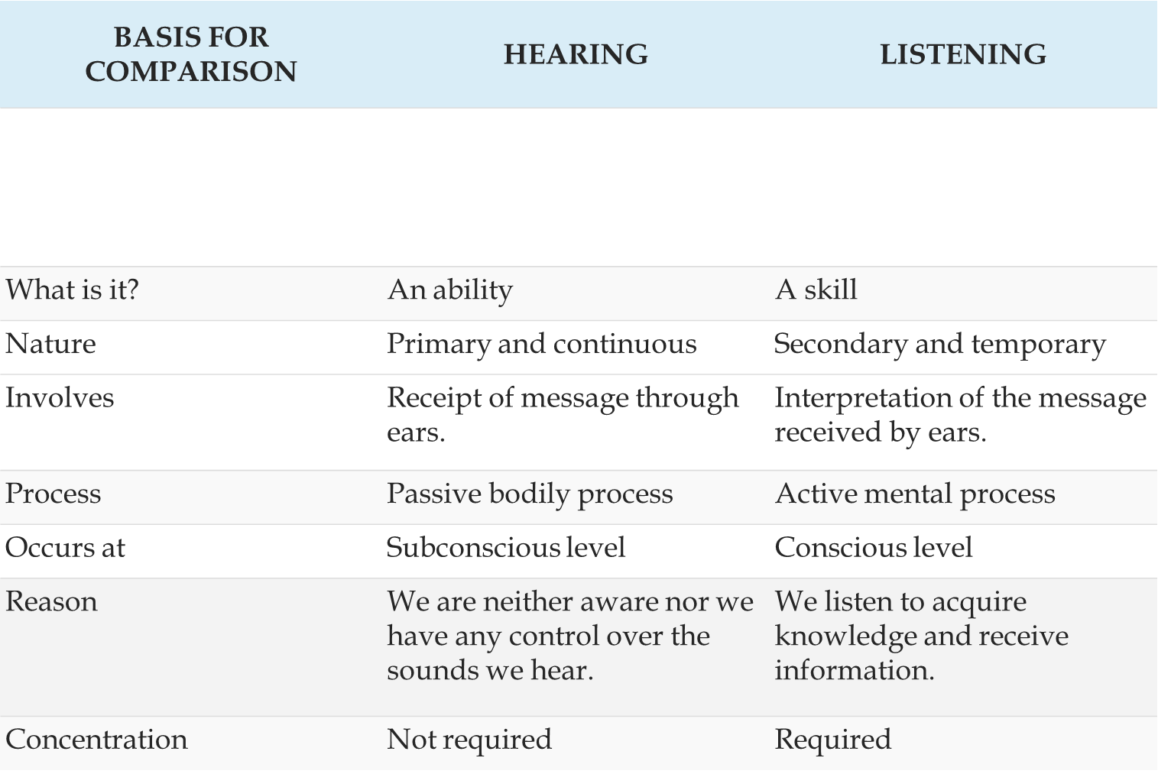

Slide 6
The Importance of Listening Being a good listener is part of having good management and
good communication skills. People spend about 70 percent of each day in communication,
more time in listening than in all other forms of communication
combined.

Slide 7
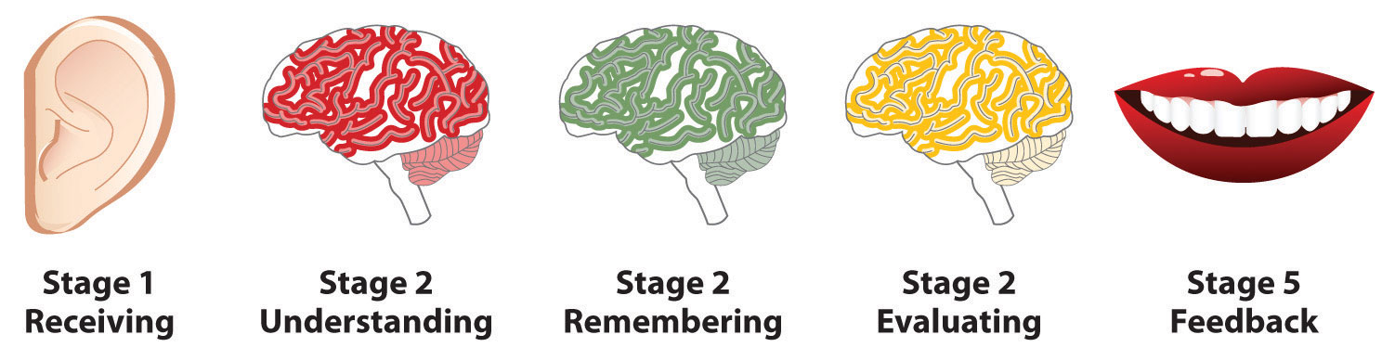
Stages of Listening
Receiving
Understanding
Remembering
Evaluating
Feedback

Slide 8


Stages Of Listening
Receiving:
is the intentional focus on hearing a speaker’s message, which happens when we filter out other sources so that we can isolate the message and avoid the confusing mixture of incoming stimuli.
Understanding:
is the process of making sense of a
message.

Slide 9

Stages of Listening Contd.
Remembering:
If the listener is unable to remember what the speaker was saying, chances are they were not effectively or actively listening. According to Harvard Business Review, we tend to forget up to half of what we’ve heard within the first eight hours of listening to it.
Evaluating: Judging the value of the message. People are more likely to evaluate a message positively if the speaker speaks clearly, presents ideas logically, and gives reasons to support the points made

Slide 10

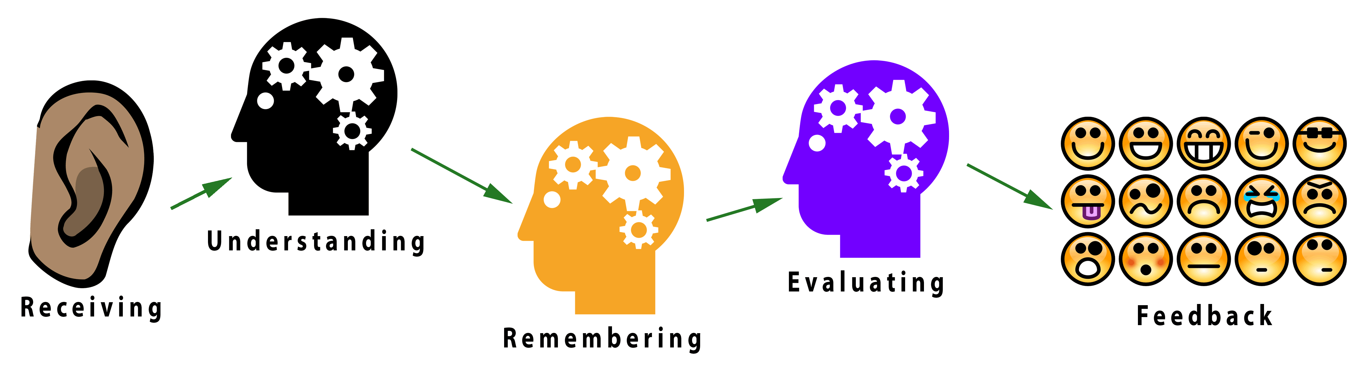
Responding or Giving feedback:
It consists of giving observable feedback to the speaker. You can respond with the back channeling cues as well (for e.g: Yes, Okay, right, really, wow!)

Slide 11
Reasons for poor Listening
Lack of Effort
Message overload
Racing Thoughts
Psychological noise
Physical Noise
Hearing problems
Faulty assumptions

Slide 12
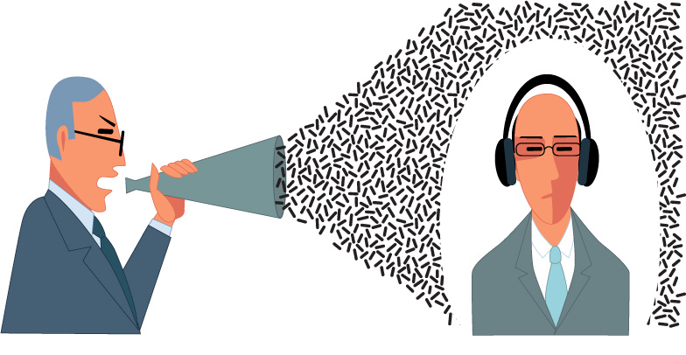
7 types of Non Listening:
Faulty Listening Behaviors
Pseudo listening
Selective listening
Defensive Listening
Ambushing
Insulated listening
Insensitive Listening
Stage Hogging

Slide 13
Faulty Listening Behaviors Contd.
Faking Attention or Pseudo Listening: People who give the appearance of being attentive, with smiles, head-nods, minimal responses, etc., but behind this polite facade, they are ignoring or not attending to the other person. Such pretense may leave the speaker with the impression that the listener has heard some important information or instructions offered by the speaker when this is not really true. Example: https://www.youtube.com/watch?v=2HLkWn2OBFc

Slide 14
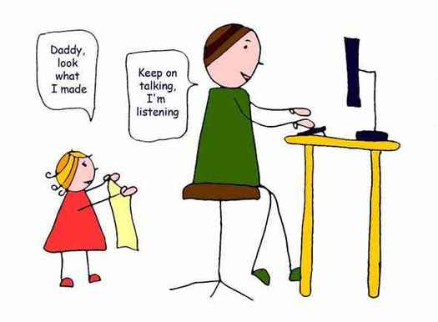
Faulty Listening Behaviors Contd.
Faking Attention or Pseudo Listening:

Slide 15
Selective Listening: People who listen only to parts of a message that interest them and reject or ignore everything else. Selective listeners have their own agenda of interesting and valuable topics and disregard or are disinterested in others’ agendas.
Defensive Listening: People who take innocent comments as personal attacks. Defensive listening creates impressions of insecurity and a lack of confidence. Example: https://www.youtube.com/watch?v=_MUX-HyRgtQ

Slide 16
Ambushing: People who listen very carefully. However, they do so to collect information that can be used against the other person. These people are constantly looking to ambush and trap the other person in their own ideas and words, usually to prove or support a strong personal belief of their own. Ambushing causes others to be defensive.

Slide 17
Stage Hogging: People who are only interested in expressing their own ideas, and who don’t care about what others have to say on the subject. Stage hogs do not listen to the other person, but give short speeches. If you dominate conversations, interrupt to take over, or constantly change the subject to talk about you and your interests, you’re a stage hog. Example: https://www.youtube.com/watch?v=SQ7H6iTDD1g

Slide 18
Insensitive Listening:
To focus on facts, not feelings. They only hear factual elements others share and
ignore verbal or nonverbal expression of emotion. As a result, they’re usually totally
unconscious to what others are really trying to communicate and their responses show it
Insulated Listening:
The opposite of selective listeners, insulated listeners are people who actively avoid or
ignore certain topics. When that topic arises in the conversation, they turn off.
Example: https://www.youtube.com/watch?v=0XXOUgqTHxQ

Slide 19
Types of Listening
Two researchers named Wolvin and Coakley have identified three types of listening. These 3 types of listening are the most common in interpersonal communication:
Informational Listening (Listening to Learn)
Critical Listening (Listening to Evaluate and Analyze)
Therapeutic or Empathetic Listening (Listening to Understand Feeling and Emotion)
In reality you may have more than one goal for listening at any given time – for example, you may be listening to learn whilst also attempting to be empathetic. https://www.skillsyouneed.com/ips/listening-types.html

Slide 20
Informational Listening
An approach we take when we want to understand another person. Whenever you listen to learn something, you are engaged in informational listening.
The goal of informational listener is to make sure that he is receiving the same thoughts the other person is trying to convey.

Slide 21
Increasing effectiveness as an Informational listener
Don’t Ague or Judge Prematurely
Separate the message from the Speaker
Be Opportunistic
Ask Questions
Paraphrasing
Take notes

Slide 22
Critical Listening
The Objective of critical listening is to judge the quality of a message in order to decide whether to accept or reject it.
We are engaged in critical listening when the goal is to evaluate or scrutinize what is being said. CL is appropriate when some one is trying to
Persuade you to buy a product
To act in a certain way Or
To accept a belief.

Slide 23
Increasing effectiveness as a Critical Listener
Evaluate the Speaker’s Credibility
Question the Speaker’s competency in relevant area
Check his or her Impartiality
Examine the speaker’s Evidence his descriptions, statistics,
analogies
Examine emotional appeals
Examine the speaker’s Reasoning

Slide 24
Empathetic or Therapeutic Listening
Empathetic listening is trying to help someone cope with a problem by seeing it from that person’s point of view and giving support during the struggle for a solution.
Counsellors and therapists use therapeutic or empathic listening to understand and ultimately help their clients. This type of listening does not involve making judgments or offering advice but gently encouraging the speaker to explain and elaborate on their feelings and emotions.

Slide 25
Steps to Empathetic Listening
You need to assess your ability to listen.
You need to assess the immediacy of the problem.
You need to prepare yourself physically (no distractions) and psychologically (nothing else on your mind) to listen.
You should listen for feelings without making judgments.

Slide 26
Thank you
Insert the title of your subtitle Here

